Slide 1

MALL CUSTOMER DATA ANALYSIS
INSTITUTE OF TECHNOLOGY & SCIENCE
MOHAN NAGAR, GHAZIABAD
Batch: 2021-2024
Submitted By
RUDRAKSH KAUSHIK
(210934106262.)

Slide 2
CONTENT
Introduction
Dataset
Architecture Overview
Terms Related To Architecture
Methodology
Implementation And Analysis
Age Plot
Gender Plot
Age Vs Spending Score
Annual Income Vs Spending Score
Conclusion
Data Flow Diagram

Slide 3
1: Introduction
This project deals in the study and analysis of potential customer visiting malls and similar places very frequently customer segmentation is a popular application of unsupervised learning using clustering we identify segment /part of customer to target the potential user based this divided the customer into groups according to common characteristic like gender, age, interest and standing habits.
For example, a group of customers have high income but their spending score (amount spent in the mall) is low so from the analysis we can convert such type of customers into potential customers (whose spending score is high) by using strategies like better advertising, accepting feedback and improving the quality of products.

Slide 4
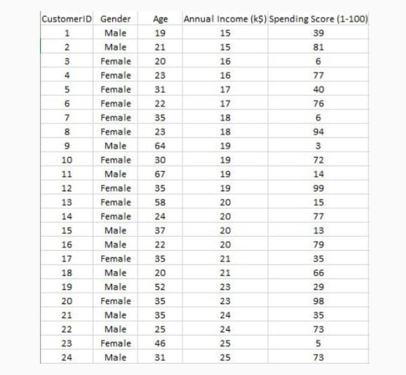
2: Dataset
The dataset name is Mall customer.csv consisting five attributes which are gender, customer I'd, age , annual income and spending score .
The maximum size of data set is (200,5) i.e. 200 rows and 5 columns

Slide 5
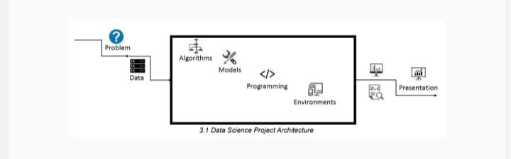
3: Architecture Overview

Slide 6
4: Terms Related To Architecture
The maximum size of data is (200,5) .It has 200 rows and 5 columns. It has no null values
Algorithm: k-means algorithm is used in project to analyse data and form cluster based on criteria given
Programming language – Python
Environment (library and technology) : Numpy, pandas , matplotlib, jupyter

Slide 7
5: Methodology
Creating an approach to solve the given problem statement
Exploring the dataset and obtaining useful insight from the same
Cleaning the dataset by handling nan values, remove duplicate records, etc.
Data Visualization used to obtain important information from the data
Data Preprocessing is performed to make the data ready to fit the model this includes
feature scaling, splitting the dataset into features and labels, etc.
Model Building

Slide 8
6: Implementation And Analysis
Implementation and analysis:
On analysing the data we obtained various results, that provided the base for further study.

Slide 9
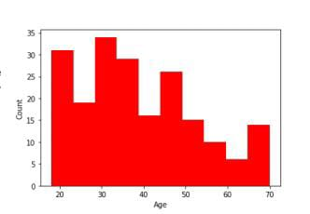
7: Age Plot
Age plot analysis:
From the Histogram it is evident that there are 3 age groups that are more frequently shop at the mall, they are: 15-22 years, 30-40 years, and 45-50 years.

Slide 10
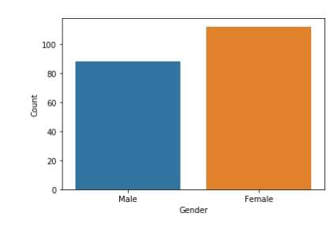
8: Gender Plot
Gender plot analysis:
From the Count plot, it is observed that the number of Female customers is more than the total number of Male customers.

Slide 11
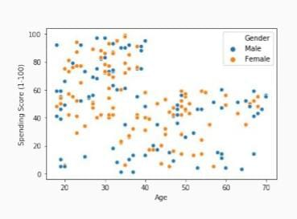
9: Age Vs Spending Score
1) From the Age Vs Spending Score plot we observe that customers whose spending score is more than 65 have their Age in the range of 15-42 years. Also from the Scatter plot it is observed that customers whose spending score is more than 65 consists of more Females than Males.
2) The customers having average spending score ie: in the range of 40-60 consists of the age group of the range 15-75 years and the count of males and females in this age group is also

Slide 12
10: Annual Income Vs Spending Score
We observe that there are 5 clusters and can be categorized as:
a) High Income, High Spending Score (Top Right Cluster)
b) High Income, Low Spending Score (Bottom Right Cluster)
c) Average Income, Average Spending Score (Center Cluster)
d) Low Income, High Spending Score (Top Left Cluster)
e) Low Income, Low Spending Score (Bottom Left Cluster)

Slide 13
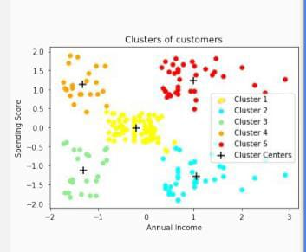
11: Conclusion
a) High Income, High Spending Score (Cluster 5) - Target these customers by sending new product alerts which would lead to an increase in the revenue collected by the mall as they are loyal customers.
b) High Income, Low Spending Score (Cluster 2) - Target these customers by asking the feedback and advertising the product in a better way to convert them into Cluster 5 customers.
c) Average Income, Average Spending Score (Cluster 1) - May or may not target these groups of customers based on the policy of the mall.
d) Low Income, High Spending Score (Cluster 4) - Can target these set of customers by providing them with Low-cost EMI's, etc.
e) Low Income, Low Spending Score (Cluster 3) - Don't target these customers since they have less income and need to save money.

Slide 14
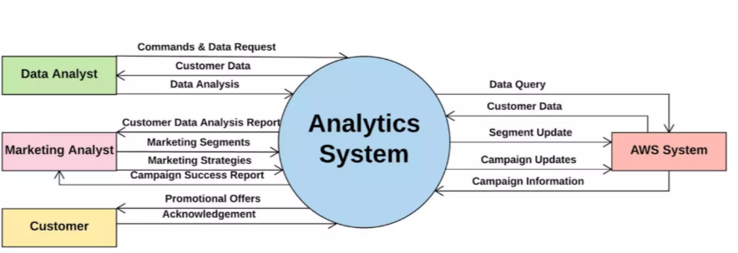
12: Data Flow Diagrams

Slide 15
THANK YOU

